Slide 1
Global Health Supply Chain Maturity Model
Assessment version 8.0
Month xx, 2020

Slide 2
Presenters
Photo
Photo
Photo
Name
Title
Organization
Name
Title
Organization
Name
Title
Organization

Slide 3
Introductions
Name
Organization
Position
Roles
One expectation
One non-work activity you enjoy

Slide 4
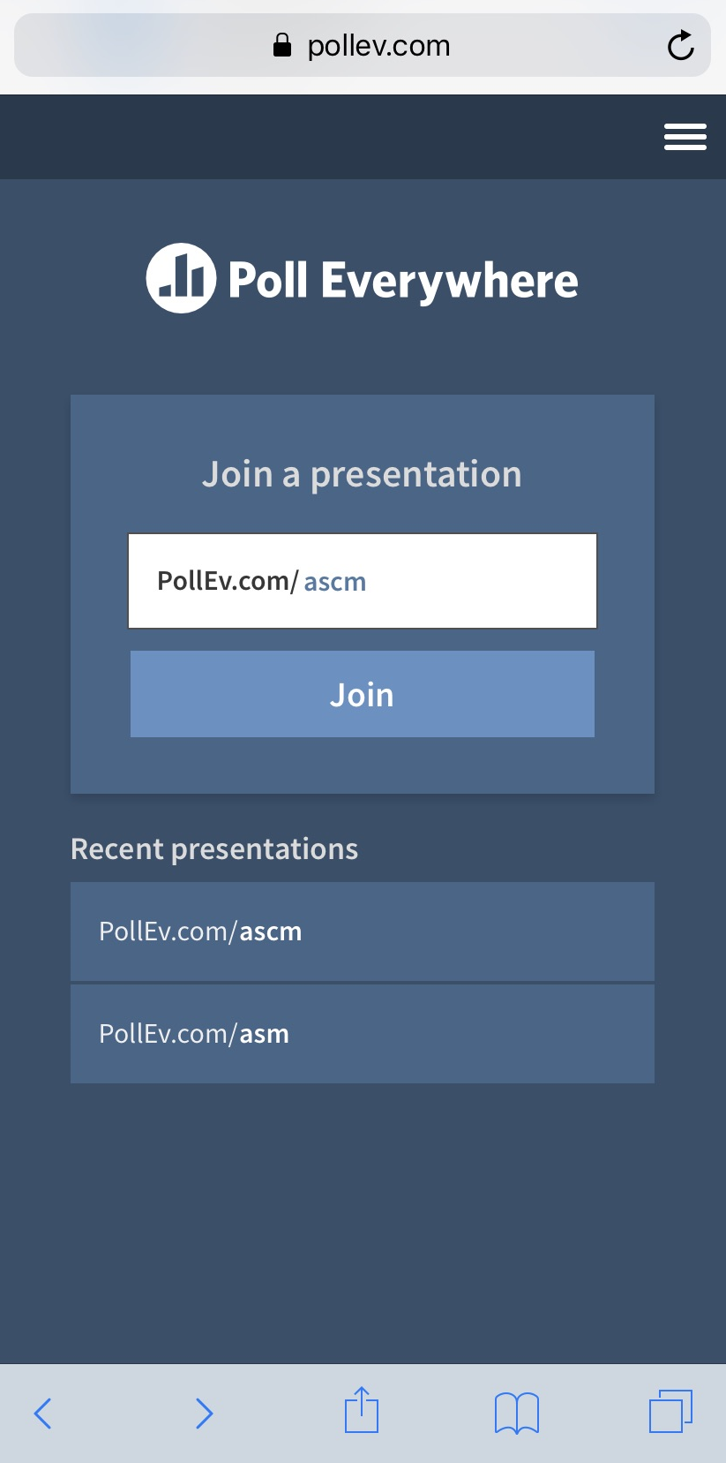
Virtual assessment instructions
Zoom instructions:
Video connect to Zoom via computer or tablet
Audio connect to Zoom via computer, tablet, or phone
Poll Everywhere instructions:
Connect your computer, tablet, or smartphone to the internet
Connect to PollEv.com/ascm
A questionnaire will appear
Make choices according to the presenter’s instructions

Slide 5
Maturity Model assessment training objectives
Describe the rationale for the Maturity Model
Explain how the Maturity Model improves supply-chain performance
Describe the levels of supply-chain maturity
Describe the advance planning necessary for effective evaluation and monitoring of improvement projects
Describe the Maturity Model process
Explain the results of the Maturity Model
Describe how to use the results of the Maturity Model to develop improvement projects

Slide 6
Maturity Model Support Materials

Slide 7
Maturity Model — Assessment

Slide 8
Maturity Model — Playbook

Slide 9
Maturity Model — Toolbox

Slide 10
Questions and Answers

Slide 11
What information in this session did you find most relevant and helpful?

Slide 12
Global Health Supply Chain (GHSC) Maturity Model Overview

Slide 13
Global Health Supply-Chain Maturity Model fosters continuous improvement
Overview
Self-assessment tool that helps sites, supply chains, counties, regions, and countries to independently assess supply-chain needs
Progress measurement
Periodic self assessments
Identify bottlenecks and performance gaps
Prioritize improvement opportunities
Continued removal of constraints
Improved visibility
Increased product availability
Greater supply-chain efficiency
Maximize investments
ACCREDITED
Supply-Chain Performance
GOLD
PRODUCT AVAILABILITY
SILVER
There is a relationship between maturity and supply-chain performance.
BRONZE
SUPPLY-CHAIN MATURITY

Slide 14
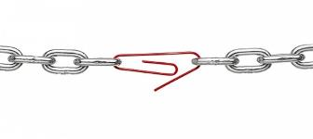
How does the Supply-Chain Maturity Model increase performance?
Theory of Constraints
The lowest performing element of the supply chain decreases overall performance.
Removing this “weakest link” is a fast and effective way to improve performance.
ACCREDITED
Supply Chain Performance
GOLD
PRODUCT AVAILABILITY
SILVER
BRONZE
CANVAS
SUPPLY CHAIN MATURITY
The Maturity Model highlights the most problematic constraint or “weakest link” to achieving supply-chain goals.
The SC Maturity Model helps increase performance by:
Focusing efforts on improving weakest-link constraints.
Helping teams stay on top of the dynamically shifting weakest link, which changes as a supply chains mature
Highlighting areas where maturity impacts the supply chain's ability to function in a given market environment
Notes:
Facilitator Notes:
How does the SC MM increase performance?
1 – First we assume the Theory of Constraints holds true as the fastest and most effective way to improve performance. This states that the lowest performing element of the supply chain pulls down overall system performance. This is especially critical in supply chains with many organizations and constantly moving needs, products and information need to be managed.
2 – The SC Maturity Model highlights the weakest link to achieving your supply chain goals.
3a – By looking for the weakest link, you can focus efforts to remove these constraints, and thereby speed your path to improved performance.
3b – As supply chains improve their performance, the weakest link changes. By using the maturity model you can stay aware of those areas that need attention
3c – Sometimes there are external ‘Market Constraints’ which will impact a supply chains efforts to improve. The maturity model will help to highlight these areas as well.
Definition:
(Note: recommend using Constraint for consistency) - A bottleneck (resource) is a resource with capacity less or equal to demand while a constraint is a limiting factor to organization's performance, an obstacle to the organization achieving its goal. A constraint can be called bottleneck but a bottleneck is not always a constraint.

Slide 15
Levels of the Maturity Model highlight multidimensional progress
CANVAS
BRONZE
SILVER
GOLD
ACCREDITED
Looks like
Very basic
Basics need to be stronger
Basic processes working
Manual and people-dependent
No process controls
Functioning supply chain
Visibility available
Consistently performing supply chain
Accountability structures
Accredited
Capabilities are consistently displayed
Independent from technical and financial assistance from external donors
Performance Indicators
Focus on product availability at service delivery points
<60% product availability
Limited visibility
60-85% product availability
Basic visibility
85-95% product availability
Full visibility
Some efficiency – e.g., less inventory needed
>95% product availability
Efficiency – e.g., fewer touches, higher turns
Very lean; low process variability
Key Priorities
Absolute basic capabilities
Access to cash
Basic visibility
Execute functions more regularly
Designing efficient workflows to deliver product to last mile vs. collection systems
Visibility to product, information, financials
Efficiency
Reducing waste in product, time, and money
Continuous improvement
Investor Implications
Difficult to measure
Focus on progress toward capabilities
Limited data
“Soft skills” and performance management likely a focus
Data is available; sharing based on data-use agreements
Governance, accountability, ownership, and leadership provided with data
Supply-chain transparency
Notes:
Facilitator Notes:
What do the levels of the SC Maturity Model mean?
Lets get into some details of each level, starting with BRONZE, Bronze looks like “Basic processes are working”, etc.
Does this look familiar?

Slide 16
Questions and Answers

Slide 17
What information in this session did you find most relevant and helpful?

Slide 18
GHSC Maturity Model Assessment Process

Slide 19
Maturity Model assessment process: Teams access website and identify the supply chain that is being examined
The Maturity Model (MM) assessment is available as an online questionnaire.
Teams access the Global Health Supply Chain Maturity Model v8.0 at the an online website (the following link is for a demonstration site where attendees can trial the assessment):
Global Health Supply Chain Maturity Model v8.0
Once at the online site, the team will provide profile information regarding the assessment, including:
Country and Region/State/County
District/Organization/Other
Date of completion
Name of individuals or team completing the evaluation
Type of organization (private, public, or NGO)
Registration code (provided by ASCM) or an email address for self-assessments
Commodity Type
Notes:
NOTE: The hyperlink will only work in slideshow view.

Slide 20
Maturity Model assessment process: 20 categories help to define “maturity level” throughout the supply chain
Teams answer questions in 20 supply-chain categories.
Most questions gauge the level of supply-chain maturity:
Canvas
Bronze
Silver
Gold
Accredited
Categories are defined that map to standard supply-chain management processes.

Slide 21
Maturity Model assessment process: Constraints are identified that prevent supply-chain improvement
For each MM category, teams also identify constraints that prevent improvement of the supply-chain category; teams can select more than one constraint that affects a category:
Human resources
Improvement-process knowledge
Enabling technologies
Leadership/guidance
National guidelines
Funding
Infrastructure
Government support
No public/private collaboration
Other (please specify)

Slide 22
Maturity Model assessment process: Glossary helps to answer questions and clarify Maturity Model terms
Frequently asked questions in Maturity Model workshops revealed a need for clarity on specific words or phrases.
The MM Glossary defines words and provides examples so that all participants work from a common understanding of the supply-chain Maturity Model.
This reference document can also reduce different interpretations by facilitators.
Definitions of commonly discussed words are available in a Microsoft Word document and in additional Maturity Model facilitation presentation materials.

Slide 23
Maturity Model assessment process: Dashboard Summary reveals supply-chain strengths and weaknesses
Each category is scored for percentage of process maturity, based on an average of question answers in the category:
20% = Canvas
40% = Bronze
60% = Silver
80% = Gold
100% = Accredited
Investing where a component is already strong is unlikely to result in better performance.
Increasing performance can be achieved by investing in the weakest areas of individual supply chains.
An overall assessment score is identified beneath the category scores.
Each category also has a visual that identifies constraints, if any.
Where constraints exist, investing to remove those constraints may improve the entire supply chain.

Slide 24
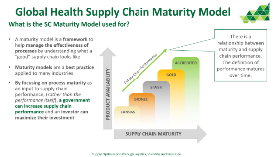
Maturity Model assessment process: Tactical considerations for using the Maturity Model
The MM assessment takes 1 hour to 3 hours to conduct. Teams should try to answer all questions at a maturity level, but it may be necessary to respond “Not applicable” or “Don’t know,” which also provides useful information for follow-up.
Data summary shows areas of largest impact potential, where constraints exist, and where more information about the supply chain is required.
Teams who have used the Maturity Model see this as a way to independently assess supply-chain needs, and to clarify stakeholder expectations against the reality of the current supply-chain maturity level.
Maturity Model concept takes 30-45 minutes to introduce and discuss.
Intended for teams to complete the Maturity Model as a self-assessment tool

Slide 25
Questions and Answers

Slide 26
What information in this session did you find most relevant and helpful?

Slide 27
From GHSC MM Assessment to Supply-Chain Improvements

Slide 28
Use Maturity Model assessment results to improve the supply chain
1
2
GOLD
Determine the current state of maturity overall and in the 20 categories.
Identify the current “weakest link” to begin focusing resources and effort for the greatest impact.
SILVER
BRONZE
3
Team members have informed discussions on how to create improvements in supply-chain performance and submit 5 to 10 ideas each. Using a 2X2 matrix (Impact X Difficulty), the team prioritizes actions.
4
Determine or update your supply-chain improvement roadmap. Record plans on an Improvement Plan worksheet.
5
Business Case
Advance maturity from Bronze to Silver
Increase Visibility
Focus on Process Improvement
Use results to support requests for resources for projects that improve performance by removing supply-chain constraints
6
Use progress improvements to improve team morale and engage more individuals and entities in supply-chain improvements.

Slide 29
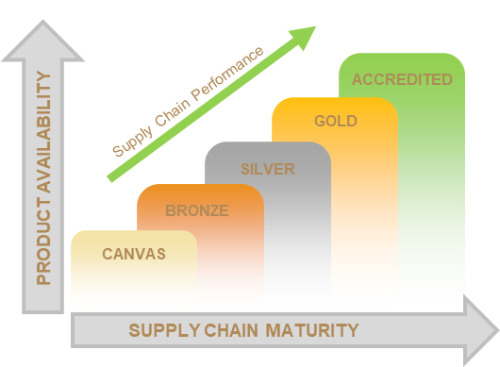
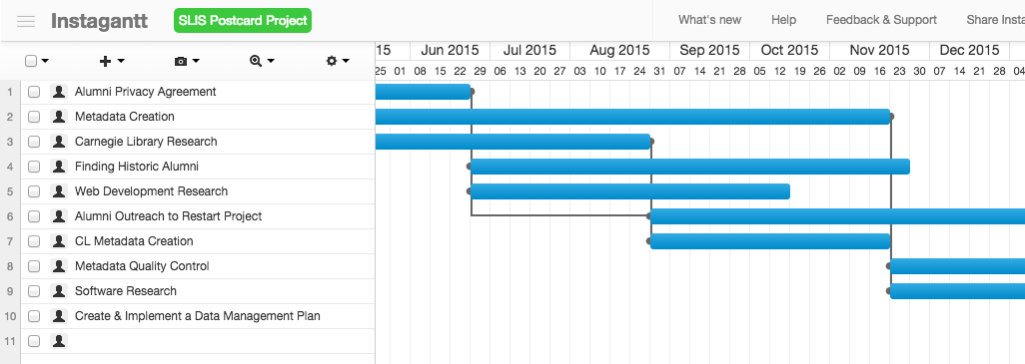
Maturity Model provides cycle of supply-chain measurement and improvement
Supply-chain performance improves
Supply-chain team completes Maturity Model assessment
Dashboard Summary identifies improvement project opportunities
Team plans and carries out improvement projects

Slide 30
Questions and Answers

Slide 31
What information in this session did you find most relevant and helpful?

Slide 32
Maturity Model Categories and Questions
Notes:
This section of the Facilitator Guide gets the facilitator used to the questions and how they can be presented to teams. Refer to the actual questionnaire for question answers if desired.

Slide 33
Maturity Model categories
Service-Delivery Point (SDP)/ Health Facility (HF)Visibility
SDP/HF Inventory Management
SDP/HF Order Management
Warehouse/Store Visibility
Warehouse/Store Inventory Management
Warehouse/Store Order Management
Warehouse/Store Operations
Transportation
Expiry Management
Procurement
Infrastructure and Assets
Performance Management
Analysis and Evaluation
Demand Planning
Supply Planning
Fund Management
Financial Management
Governance
Staff Training/Development
Patient-Focused Performance

Slide 34
Assessment Profile
1. Please include the following information:
Country and Region/State/County: (required)
District/Organization/Other: (optional)
Date of Completion:
Name of Individuals or Team Completing the Evaluation:
Type of Organization (Private, Public, or NGO):
Is this assessment supported by a donor organization?
No
Yes (please name donor):
Registration: (choose one)
Registration code:
Self-assessment: (For self-assessment, you must provide an email address below)
2. Please indicate the commodity type for which the assessment is being completed. (choose one)
Family Planning
Reproductive Health
Essential Medicines
Vaccines
HIV
Malaria
Tuberculosis
Integrated Commodities (please describe the commodities):
Other (please specify):
Assessment teams will be given a registration code by an ASCM country director or associate director.

Slide 35
Assessment Profile (continued)
3. Which supply-chain stakeholders are represented in the assessment? (choose all that apply)
National (identify by name):
State (identify by name):
County (identify by name)
Sub-county/Community (identify by name):
Site (identify by name):
Other (please specify):
4. How many assessments have been conducted previously with this same scope and supply chain? (choose one)
0
1
2
3
4
5
More than 5
Don’t know
5. What is the primary source of the information for this assessment? (choose one)
First-hand experience
First-hand experience and second-hand information (from another person or information system)
Second-hand information (from another person or information system)

Slide 36
I. SDP/HF Visibility
Service Delivery Points/Health Facilities generate data regarding the inventory levels and consumption of product on site. As maturity increases, the supply chain increasingly receives real-time data from SDPs/HFs that feeds into a broader supply-chain digital platform.
Objective: Improve the visibility and tracking of inventory at the SDP/HF.
6. Please describe the visibility of inventory and consumption from the facility(ies): (choose one)
7. Please describe the visibility of upstream supply-chain inventory information to the facility(ies): (choose one)
8. How is inventory information within the facility(ies) shared with supply-chain partners?(choose one)
9. Which of the following are constraints that prevent improvement of inventory visibility at facilities? (choose all that apply)

Slide 37
II. SDP/HF Inventory Management
Inventory in the facilities is segmented into simple product categories to improve data (e.g., quantities, expiration dates, stockouts) and provide a clearer sense of what products are needed. As maturity increases, regular audits are conducted to ensure accurate product levels and adherence to policies to maintain appropriate stock levels.
Objective: Standardize inventory-handling practices at SDP/HF to ensure that optimal levels of inventory are always available.
10. How are inventory levels within the facility(ies) established?(choose one)
11. How frequently are physical stock counts conducted within the facility(ies)? (choose one)
12. Which of the following are constraints that prevent improvement of inventory management at facilities? (choose all that apply)

Slide 38
III. SDP/HF Order Management
The facility can determine the need to order more inventory, identify that an order is based on inventory policies, and execute the order in a timely manner. As maturity increases, orders are created within a broader supply-chain digital platform on demand.
Objective: Execute order management at the SDP/HF in relation to inbound orders, outbound inventory, real-time demand, and SDP/HF budget.
13. How do/does the facility(ies) determine the need to order inventory? (choose one)
14. How is the order quantity for the facility(ies) determined? (choose one)
15. How are orders checked against the budget of the facility(ies) for the order? (choose one)
16. Which of the following are constraints that prevent improvement of order management at facilities? (choose all that apply)

Slide 39
IV. Warehouse/Store Visibility
Within supply-chain warehouse(s)/store(s), all products, inventory levels, and orders can be identified whether they are on the shelf, inbound, or outbound. As maturity increases. the supply chain has a Warehouse Management System (WMS) that is connected to a broader supply-chain platform, which allows the warehouse/store to define specific inventory level rules.
Objective: Improve the visibility and tracking of inventory within the warehouse(s)/store(s).
17. How is product located at the warehouse(s)/store(s)? (choose one)
18. Describe the ability to identify order status within the warehouse(s)/store(s)? (choose one)
19. How is inventory information in the warehouse(s)/store(s) shared with others in the supply chain? (choose one)
20. Which of the following currently are constraints that prevent improvement of visibility at warehouse(s)/store(s)? (choose all that apply)

Slide 40
V. Warehouse/Store Inventory Management
At the warehouse/store level, there is a defined amount of inventory of each product that should be maintained, based on demand. These levels are not fixed and should be updated on a regular basis. As maturity increases, regular audits are conducted to ensure accurate product levels and adherence to policies to maintain appropriate stocking levels.
Objective: Standardize inventory-handling practices at the warehouse(s)/store(s) to ensure optimal levels of inventory are available.
21. How does/do the warehouse(s)/store(s) define the optimum level of inventory to maintain? (choose one)
22. How is the current physical count of inventory in the warehouse(s)/store(s) determined? (choose one)
23. Which of the following currently are constraints that prevent improvement of inventory management at warehouse(s)/store(s)? (choose all that apply)

Slide 41
VI. Warehouse/Store Order Management
Supply-chain warehouses/stores can determine that the location needs to order more inventory, that the order is based on inventory policies, and then execute the order. As maturity increases, orders are created within a broader supply-chain digital platform as needed.
Objective: Coordinate order management at the warehouse(s)/store(s) with real-time demand from SDP/HFs and other warehouses/stores.
24. How are facility orders processed at the warehouse(s)/store(s)? (choose one)
25. What is the typical order ship-date request from the warehouse(s)/store(s) to SDP(s)/HF(s)? (choose one)
26. How are open orders in the warehouse(s)/store(s) identified and resolved? (choose one)
27. What is the complete-and-on-time delivery rate of warehouses/stores to SDPs/HFs? (choose one)
28. Which of the following currently are constraints that prevent improvement of order management at warehouse(s)/store(s)? (choose all that apply)

Slide 42
VII. Warehouse/Store Operations
Each warehouse/store can promptly receive, prepare, and ship inventory as required. As maturity increases, orders are picked accurately and moved efficiently to transportation provider(s).
Objective: Standardize warehouse/store stocking, picking, handling, and staging processes and eliminate wasteful steps to ensure product quality and increase process speed.
29. How are orders prepared for shipment? (choose one)
30. What is the inventory accuracy of the warehouse(s)/store(s)? (choose one)
31. What method of quality control is used in warehouse(s)/store(s) to ensure product integrity? (choose one)
32. Which of the following currently are constraints that prevent improvement of operations at warehouse(s)/store(s)? (choose all that apply)

Slide 43
VIII. Transportation
The supply chain can deliver product to service delivery points. Each location is documented, has a delivery schedule, knows what the delivery schedule is, and has a Proof of Delivery (POD) system in place. As maturity increases, route planning is conducted, appointments are defined, and product-delivery timing is measured and tracked.
Objective: Improve accuracy, timeliness, and efficiency of inventory transportation.
33. How is the movement of goods throughout the supply chain determined? (choose one)
34. How are product deliveries communicated to facilities? (choose one)
35. How is the receipt of product at facilities verified? (choose one)
36. Which of the following currently are constraints that prevent improvement of transportation of product throughout the supply chain? (choose all that apply)

Slide 44
IX. Expiry Management
Both warehouses/stores and service delivery points have policies to handle expired product. As maturity increases, quarantine areas are maintained and a “first- expired, first-out” (FEFO) policy is systematic and maintained.
Objective: Identify product in SDP/HFs and warehouse(s)/store(s) near expiration, minimize expired product, and prevent unsafe release of expired product.
37. What policies, guidance, and/or SOPs are in place at the SDP/HF and warehouse/store levels to identify and manage expired product? (choose one)
38. What practices are in place at SDP/HF and warehouse/store levels to dispose of expired product? (choose one)
39. Which of the following currently are constraints that prevent improvement of expiry management? (choose all that apply)

Slide 45
X. Procurement
The procurement process for product can be executed in a reasonable time frame. Within this maturity model, procurement is defined as the issuance of a purchase order to a previously established supplier, the approval of said purchase order by the vendor(s), shipment of goods, and receipt of goods. As maturity increases, the speed of the procurement process increases, levels are based on demand, and prices are competitive with national standards.
Objective: Rapidly procure the optimal amount of appropriately priced inventory to satisfy real-time demand.
40. How long does it take to procure product (purchase order under an existing contract)? (choose one)
41. How is the procurement quantity determined? (choose one)
42. What is the typical frequency for the procurement of product?
43. Which of the following currently are constraints that prevent improvement of procurement processes? (choose all that apply)

Slide 46
XI. Infrastructure and Assets
The buildings in the supply chain are appropriate for storing and managing products in sound condition. As maturity increases, internet access is prevalent at all locations and facility risks are identified and managed.
Objective: Establish buildings for product and personnel that are safe, secure, and technology-enabled.
44. How are products maintained in secure and sound condition at facilities? (choose one)
45. To what extent is internet access available at facilities? (choose one)
46. Which of the following currently are constraints that prevent improvement of supply-chain infrastructure and assets? (choose all that apply)

Slide 47
XII. Performance Management
Each process in the supply chain has a defined set of performance indicators that are managed, and effort is made to improve them over time. Decision-making processes are driven by supply-chain data that populates scorecards. As maturity increases, data analytics are used in determining and improving supply-chain and staff performance.
Objective: Establish a system to align and continuously improve performance at all sites consistent with overall supply-chain goals.
47. How are problems and opportunities for improvement identified? (choose one)
48. Describe the skill level of staff in identifying and solving problems? (choose one)
49. To what extent are teams empowered to solve problems independently? (choose one)
50. Which of the following currently are constraints that prevent improvement of performance management? (choose all that apply)

Slide 48
XIII. Analysis and Evaluation
The supply chain uses data to understand properly functioning processes and to identify deviations from the norm. Data from orders, shipments, receipts, and other supply-chain events are tracked to monitor process flow. As maturity increases, regular team reviews of supply-chain data and analytics identify areas for improvement.
Objective: Establish capabilities whereby data alerts sites and the overall supply chain to problems and opportunities for improvement.
51. How does data analysis and evaluation occur? (choose one)
52. How frequently are analysis findings reviewed? (choose one)
53. Which of the following currently are constraints that prevent improvement of analysis and evaluation processes? (choose all that apply)

Slide 49
XIV. Demand Planning/Management
The supply chain quantifies consumption and creates a forecast for future commodity requirements based on multiple factors (historical usage, known fluctuations, etc.). As maturity increases, the demand assumptions and plan are held in the broader supply-chain digital platform to influence decision-making.
Objective: Improve the accuracy of demand forecasting and eventually automate forecasting capabilities.
54. How is demand planned? (choose one)
55. How frequently is the demand plan checked for accuracy? (choose one)
56. Which of the following currently are constraints that prevent improvement of demand planning/management? (choose all that apply)

Slide 50
XV. Supply Planning/Management
A strategy is in place for how the supply chain will maintain appropriate levels of each commodity. As maturity increases, the supply plan is based on demand and inventory, and is tracked in the broader supply-chain digital platform.
Objective: Plan and tightly coordinate supply-chain actions and inventories with the demand plan.
57. How is supply planned? (choose one)
58. Which of the following currently are constraints that prevent improvement of supply planning/management? (choose all that apply)

Slide 51
XVI. Fund Management
The sources of funds available to the supply chain are known, and commitments are documented and tracked. As maturity increases, funding needs are identified and managed actively in a broader supply-chain digital platform.
Objective: Improve accuracy and timeliness of fund-tracking in order to proactively pursue new funds to address emerging needs.
59. How are funding sources and commitments tracked and monitored? (choose one)
60. Which of the following currently are constraints that prevent improvement of fund management? (choose all that apply)

Slide 52
XVII. Financial Management and Costing
Supply-chain costs incurred from procurement to receipt by the beneficiary are documented. As maturity increases, the supply chain establishes budgets based on known costs for each function at each facility, actively manages deviations, and has full visibility to the financials at each level.
Objective: Improve accuracy and timeliness of financial tracking across the supply chain to ensure optimal use of funds and establish appropriate budgets for the sites/overall supply chain.
61. How are supply-chain costs tracked? (choose one)
62. Which of the following currently are constraints that prevent improvement of financial management and costing? (choose all that apply)

Slide 53
XVIII. Governance
Appropriate structure is established to define roles and responsibilities for teams, individuals, and change agents within the supply chain. Teams have established goals and performance-management structures. As maturity increases, all processes are documented.
Objective: Roles for individuals, teams, and sites are clearly documented and understood, creating opportunities for collaboration, empowerment, and knowledge development.
63. To what extent are team roles and responsibilities within the supply chain understood? (choose one)
64. How would you describe leadership roles within the supply chain? (choose one)
65. Which of the following currently are constraints that prevent improvement of governance processes? (choose all that apply)

Slide 54
XIX. Staff Training/Development
Staff have the skills to perform well in their positions. As maturity increases, staff have access to certifications, training and cross-training, and tools that will support their continued development.
Objective: Engage, educate/develop, and empower staff across the supply chain, improving their abilities to identify and solve supply-chain problems.
66. How knowledgeable are staff regarding supply-chain management processes, practices, and tools? (choose one)
67. What expertise do staff have in supply-chain improvements? (choose one)
68. Which of the following currently are constraints that prevent improvement of staff training and development? (choose all that apply)

Slide 55
XX. Patient-Focused Performance
The supply chain and all parties within it measure last-mile product/medicine access, availability, and affordability, and collaboratively work to eliminate problems that impact product/medicine access, availability, and affordability.
Objective: Patients have efficient access to SDPs/HFs, and product/medicines are readily available and affordable.
69. Please rate patients’ access to facilities and services. (choose one)
70. Please rate the availability of product/medicines at the facility(ies). (choose one)
71. How do facility procurement prices for products/medicines impact patients? (choose one)
72. Which of the following currently are constraints that prevent improvement of access, availability, and affordability? (choose all that apply)

Slide 56
Questions and Answers

Slide 57
What information in this session did you find most relevant and helpful?

Slide 58
Maturity Model Data Visualization
Notes:
This section of the Facilitator Guide gets the facilitator used to the questions and how they can be presented to teams. Refer to the actual questionnaire for question answers if desired.

Slide 59
Platform for viewing results, reporting, and setting goals

Slide 60
Team output immediately following an assessment

Slide 61
Filter past assessments by user-defined characteristics

Slide 62
Identify supply-chain progress over time

Slide 63
Questions and Answers

Slide 64
What information in this session did you find most relevant and helpful?

Slide 65
Next Steps and Assessment

Slide 66
Next steps and priorities
Implement a multiyear plan that includes:
Documentation of good evaluation practices and Maturity Model assessments
Performance of assessments in country and the African region
Empowerment of individuals in the field in the self-assessment of their supply chain
Institutionalize the Maturity Model v8.0 as a standard for assessing and monitoring supply-chain maturity
Launch an annual report on the maturity of the public health supply chain to raise awareness:
Provide data for decision-making
Plan for and strengthen the public-private partnership to benefit healthcare supply chains
Integrate the Maturity Model into academic and professional training programs to continue awareness and capacity building
Create a certification program that recognizes qualified facilitators of the Maturity Model

Slide 67
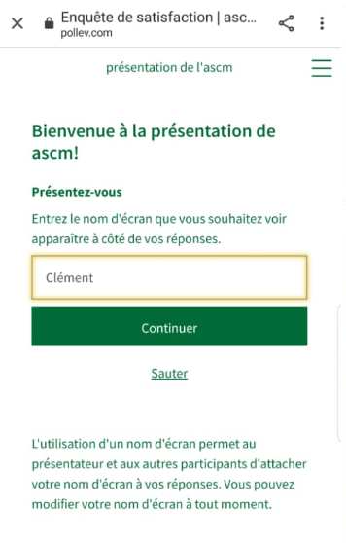
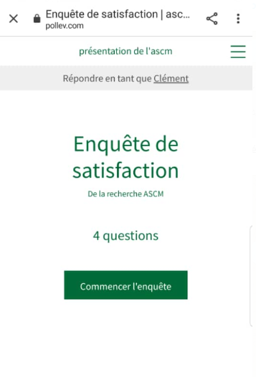
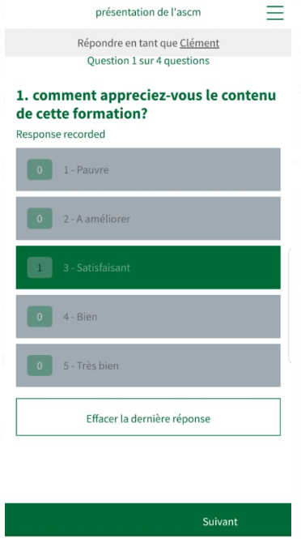
Complete the training evaluation
3
1
2
4

Slide 68
What did you like most about the training?

Slide 69
Satisfaction Survey

Slide 70
End of training — thank you for attending

